Slide 1


Chapter 3:Introduction to Visual Basic 6.0
Beginner's overview of classic programming language fundamentals
Compiled by Ms. Dianne Sikinapi & Ms. Odilia Tita
Notes:
---

Slide 2

Introduction to Visual Basic 6.0
VB6 Overview and Popularity
  VB6 is a 1998 programming language and IDE widely used for building Windows applications with easy GUI design.
Drag-and-Drop Design
  VB6’s drag-and-drop feature enables rapid prototyping and deployment without extensive coding knowledge.
Event-Driven Programming
  VB6 supports event-driven programming where controls respond to user actions like clicks and selections.
Legacy and Learning Value
  Though legacy, VB6 helps maintain older systems and teaches foundational programming and component-based development.
Notes:
Visual Basic 6.0 (VB6) is a programming language and integrated development environment (IDE) developed by Microsoft, widely used for creating Windows-based applications. Released in 1998, VB6 introduced a simplified approach to building graphical user interfaces (GUIs) and event-driven applications, making it popular among beginners and professionals alike. Its drag-and-drop design capabilities and intuitive syntax allowed developers to rapidly prototype and deploy applications without extensive coding. VB6 operates on the principle of combining visual design with procedural code, enabling developers to manipulate forms, controls, and objects seamlessly. The language supports object-oriented concepts such as encapsulation and modularity, though it is not fully object-oriented like modern languages. VB6 applications typically consist of forms, controls, and event handlers that respond to user actions, such as button clicks or menu selections. Despite being considered legacy software today, VB6 remains relevant in maintaining older enterprise systems and understanding foundational programming concepts. Learning VB6 provides insights into event-driven programming, component-based development, and the evolution of Microsoft’s development tools. This introduction sets the stage for exploring VB6’s environment, object model, and project structure, which are essential for creating functional Windows applications. By mastering VB6 basics, students gain a strong foundation for transitioning to modern languages like VB.NET or C#, while appreciating the historical significance of VB6 in software development.

Slide 3
Learning Objectives
By the end of this Unit, students should be able to:
  Explain the term event-driven programming.
  Explain the concept of objects, properties and methods.
  List and describe the three steps of Writing a Visual Basic project.
  Describe the various files that make up a Visual Basic project.
  Identify the features of a Visual Basic Environment.
  Define Design Time mode, Run Time mode and Break Time mode.
  Look up Visual Basic topics in Help.
  See Textbook - Introduction to Programming Book 1 Pages 53 - 88

Slide 4

Learning Objectives
Fundamentals of VB6
  Learn VB6 syntax, structure, and event-driven programming essential for Windows development.
Visual Basic Environment
  Explore key VB6 tools like Project Explorer, Properties window, Toolbox, and Form Layout window.
Application Design and Coding
  Gain hands-on experience designing forms and coding event handlers for user interaction.
Debugging and Deployment
  Develop skills to debug, troubleshoot, and deploy VB6 applications effectively.
Notes:
The primary learning objectives for this module on Visual Basic 6.0 are designed to equip students with both theoretical understanding and practical skills. First, students will learn the fundamentals of VB6, including its syntax, structure, and event-driven programming model. This involves understanding how VB6 differs from other languages and why it was pivotal in Windows application development. Second, learners will explore the Visual Basic environment, including key components such as the Project Explorer, Properties window, Toolbox, and Form Layout window. Familiarity with these tools is essential for efficient navigation and project management. Third, students will gain hands-on experience in designing and coding Windows applications using VB6, starting from simple forms to more complex projects. This includes writing code for user interactions, managing object properties, and implementing logic through event handlers. Fourth, the course emphasizes understanding the object model, which underpins VB6’s approach to organizing controls and forms. Finally, learners will develop the ability to create, debug, and deploy VB6 projects, ensuring they can troubleshoot common issues and optimize application performance. By achieving these objectives, students will not only master VB6 basics but also build transferable skills applicable to modern programming environments, preparing them for advanced courses and real-world software development scenarios.

Slide 5
3.1 What is Visual Basic 6.0?
Visual Basic 6.0 (VB6.0) is a programming language and an integrated development environment (IDE) created by Microsoft. It was released in 1998 as part of the Microsoft Visual Studio 6.0 development kit. VB6.0 is known for its ease of use and rapid application development (RAD) capabilities.
Visual Basic itself is an object oriented programming language developed by Microsoft. It derives from an earlier programming language called Basic.
VB6.0 is an event-driven programming language that provides a graphical user interface (GUI) which allows programmers to modify code by simply dragging and dropping objects and defining their behavior and appearance.
An event-driven programming language is a type of programming language that focuses on responding to events or user actions that occur during program execution. This means in the event-driven programming model, program flow is determined by events, and the program's behavior is determined by how it reacts to those events.

Slide 6
Visual Basic 6.0 was a popular and influential programming language and development environment for Windows applications during the late 1990s and early 2000s.
However, it has been largely replaced by more modern programming languages and development tools, such as Visual Basic .NET (VB.NET) and C#.
Developers are encouraged to use these newer technologies for Windows application development, as they offer improved performance, security, and compatibility with current Windows versions.
Microsoft Visual Basic comes in working model, learning edition, professional edition, and an enterprise edition. Anyone planning to do professional application development that includes the advanced features of database management should use the Professional Edition or Enterprise Edition.

Slide 7
3.2 What is a GUI?
A GUI, pronounced as gooey, stands for graphical user interface. It is a type of user interface through which users interact with electronic devices via visual indicator representations.
It allows users to interact with electronic devices, software or computers through graphical elements such as icons, buttons, windows and menus, as opposed to text-based interfaces like command line interface (CLI).
In a GUI, users can perform various tasks by manipulating these graphical elements using a mouse, touch pad, or touch screen.
The graphical user interface is designed to make the software and system more user-friendly and accessible by providing a visual representation of available options and actions. This intuitive interactive approach helps users understand and navigate complex applications and systems more easily.
GUIs have become ubiquitous in modern computing and are an integral part of most software and hardware interfaces.

Slide 8
3.3 Writing Windows Application with VB
- The Object Model
In Visual Basic, you will work with objects which have properties and methods. Visual Basic is object based; in object-based languages, you will build the code around the object.
  Objects: Think of object as a thing, or a noun. Examples of objects are forms and controls. Forms are the windows and the dialogue boxes you place on the screen; while controls are the elements you place inside the form such as textboxes, command buttons, labels, etc..
  Properties: Properties tell something about an object, such as its name, color, size, location, or how it will behave. Think of properties as an adjective that describe an object.
  Methods: Methods refers to the actions associated with objects. They are like the verbs of these objects. Some typical methods are Move, Print, Resize, Clear, etc.

Slide 9

Writing Windows Applications with Visual Basic
Event-Driven Architecture
  Visual Basic 6.0 uses event-driven programming where controls respond to user interactions like clicks and inputs.
Graphical Interface Design
  Developers design forms visually using drag-and-drop tools to add controls like buttons, text boxes, and menus.
Modular Project Structure
  Applications are organized into projects containing forms, modules, and classes to support modular development.
Rapid Development and Debugging
  VB6 enables rapid prototyping with real-time design feedback and simplified code debugging processes.
Notes:
Creating Windows applications in Visual Basic 6.0 involves leveraging its event-driven architecture and graphical interface design tools. Developers begin by designing forms, which serve as the primary user interface, using the drag-and-drop functionality provided by the VB6 IDE. Controls such as buttons, text boxes, labels, and menus are added to forms to enable user interaction. Each control has associated properties, methods, and events, which can be customized to achieve desired functionality. For example, a button click event can trigger a procedure that processes user input or updates the interface. VB6 simplifies application development by abstracting complex Windows API calls, allowing developers to focus on logic rather than low-level details. Applications are structured into projects containing forms, modules, and class files, enabling modular development. VB6 also supports ActiveX controls, which extend functionality by integrating reusable components. Writing Windows applications in VB6 emphasizes rapid development, as the IDE provides real-time feedback during design and debugging. This approach makes VB6 ideal for prototyping and educational purposes, as students can quickly visualize the impact of their code. Understanding this process lays the foundation for building robust applications that respond dynamically to user actions, a core principle of modern GUI development.

Slide 10
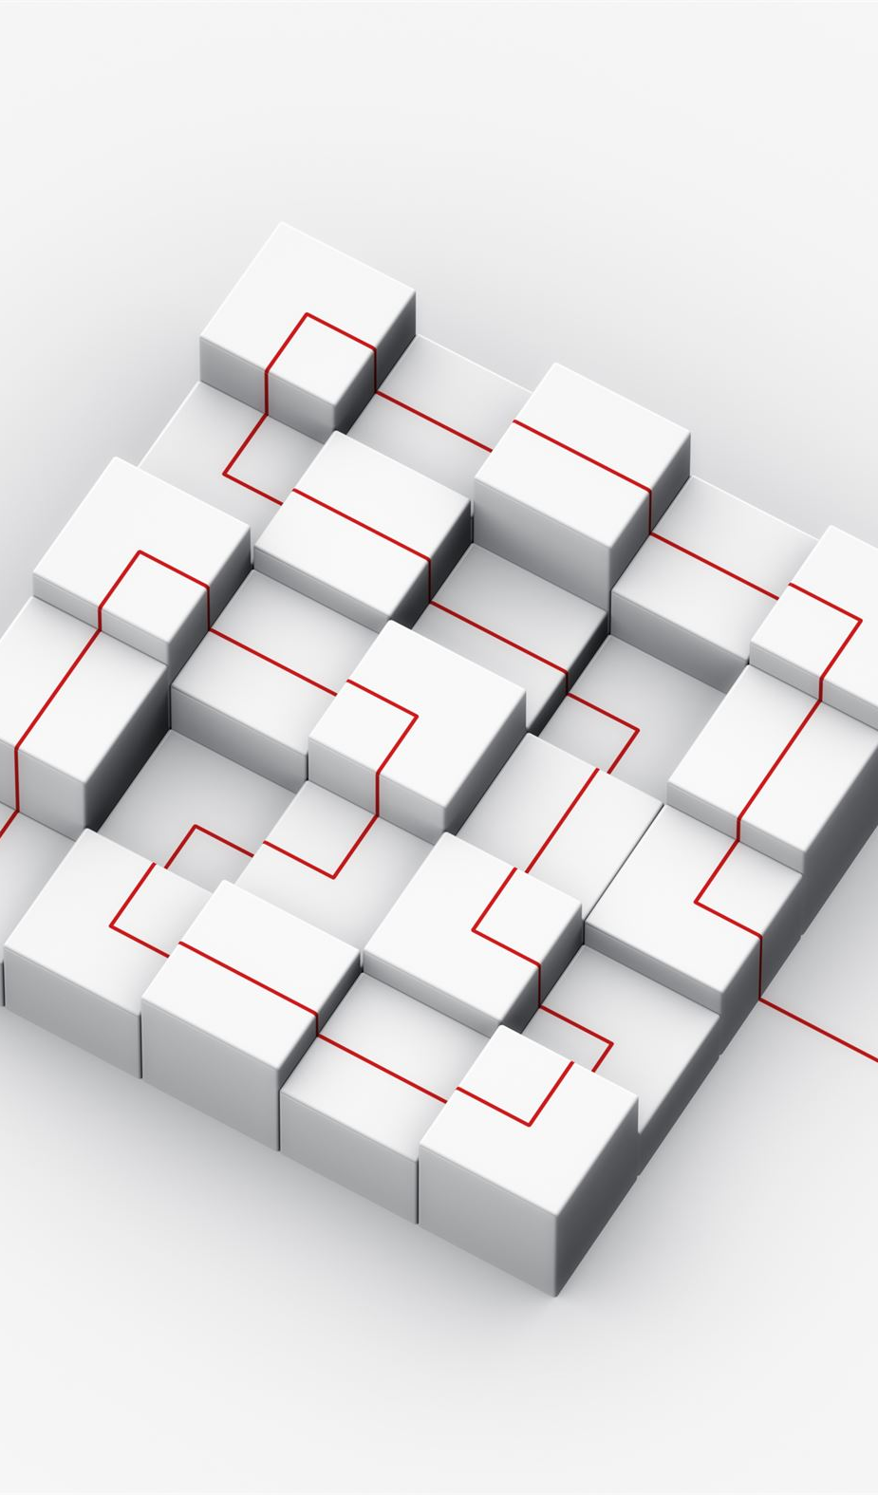
The Object Model
Core Components
  The model consists of objects, properties, methods, and events defining application structure and behavior.
Hierarchical Structure
  Forms contain controls, and projects contain multiple forms and modules for organized, modular development.
Event-Driven Programming
  Events trigger responses to user actions or system changes, enabling interactive applications.
Extensibility and Reusability
  Supports custom classes and ActiveX components for scalable, reusable software solutions.
Notes:
The Visual Basic 6.0 object model defines how elements within an application interact and are organized. At its core, the object model consists of objects, properties, methods, and events. Objects represent components such as forms, controls, and modules, each encapsulating data and behavior. Properties define the characteristics of an object, such as size, color, or text, and can be modified at design time or runtime. Methods are actions that objects can perform, such as Show or Hide for forms. Events are triggers that occur in response to user actions or system changes, like a Click event for a button. Understanding the object model is crucial because it underpins VB6’s event-driven programming paradigm. Developers manipulate objects through code, using dot notation to access properties and methods (e.g., TextBox1.Text = "Hello"). The hierarchical structure of the object model allows for organized and modular development, where forms contain controls, and projects contain multiple forms and modules. This model also supports extensibility through custom classes and ActiveX components, enabling developers to create reusable and scalable solutions. Mastery of the object model ensures efficient coding practices and facilitates debugging, as developers can predict object behavior and interactions within the application.

Slide 11
3.4 Writing Visual Basic Projects
When you write a Visual Basic project, you follow a three-step process for writing it. The three-step process are:
  Drawing the User Interface: To draw the user interface/controls onto the form, you be dragging and dropping controls on the form, or clicking the controls and clicking the form.
  Assigning Properties to Controls: When you assign properties to an object, you give each object a name and define such attributes as content of a label, the size of a text, and the word that appear on top of the command buttons and in the form’s title bar. You might think of this as describing the objects.
  Writing the Basic Code: This is where you will code the interface with the controls. You will use Basic programming statements called basic codes to carry out the action needed by your program. You will be surprised and pleased by how few statements you need create a powerful window program. You can think of this third step as the action of your program.

Slide 12

Writing Visual Basic Projects
Project Setup and UI Design
  Start VB6 projects by creating new projects and designing user interfaces with forms and controls.
Event-driven Coding
  Write event procedures responding to user actions like button clicks using VB6’s intuitive syntax.
Modularity and Code Reuse
  Use modules for shared procedures and functions to improve code reuse and maintainability.
Database Integration and Debugging
  Integrate databases with DAO or ADO and use debugging tools like breakpoints to fix errors.
Notes:
A Visual Basic 6.0 project is a collection of files that define an application, including forms, modules, and resources. Writing a VB6 project begins with creating a new project in the IDE, selecting the appropriate template such as Standard EXE for desktop applications. Developers then design the user interface by adding forms and controls, configuring properties to match functional requirements. Coding involves writing event procedures in response to user actions, such as button clicks or menu selections, using VB6’s intuitive syntax. Projects often include modules for shared procedures and functions, promoting code reuse and maintainability. VB6 supports integration with databases through Data Access Objects (DAO) or ActiveX Data Objects (ADO), enabling developers to build data-driven applications. Debugging tools within the IDE, such as breakpoints and the Immediate window, assist in identifying and resolving errors during development. Once complete, projects can be compiled into executable files (.exe) for distribution. Writing VB6 projects emphasizes structured development, where planning the interface, logic, and data flow ensures a functional and user-friendly application. This process introduces students to essential software engineering principles, including modularity, testing, and deployment, which remain relevant in modern programming practices.

Slide 13
Each Visual Basic project consist of at least two and usually more files.
  1. The .vbp file, called the project file, is a small text file that holds the name of the other files in the project, as well as some information about the VB environment. (Note that if you are using release 2.0 or 3.0 of Visual Basic, project file will have a .mak extension.)
  2. Each form in your project is saved in a file with a .frm extension. To begin, your project will only have one form (and therefore one form file). Later you can expect your project to have several forms, with one .frm file for each form. A form hold a description of all objects and their properties for the form, as well as basic codes you have written to respond to the events. In Visual Basic, each of these form file is referred to as a form module.

Slide 14
  3. Optionally, your project can have .bas extension files. These files holds basic statements that can be accessed from any form. As soon as you began writing multiform projects, you will need .bas files. The .bas files are called standard code modules.
  4. Additional controls called custom controls are stored in files with a .ocx extension. If you include controls in your project that are not part of the standard control set, the .ocx file name will be included in the project.
  5. After you saved a project, Visual Basic automatically adds one or more files to your project with an extension of .vbw. This file holds information about each of your project forms.

Slide 15
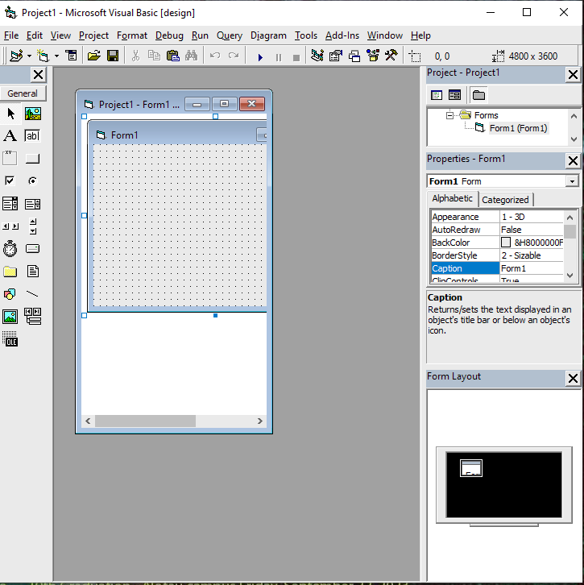
The Visual Basic Environment
8. Menu Bar
7. Main Visual Basic Window
6. Toolbar
9. Help
5. Toolbox
2. Project Explorer
3. Property Window
1. Form Window
4. Form Layout Window

Slide 16
1. Form Window: This is where you design the form that make up your interface. You can use standard window techniques to change the size and location of the form. When you begin a new project, Visual Basic gives your new form the default name form1. As soon as you save the file, you will give it a new (more meaningful) name.
2. Project Explorer Window: This holds the filenames included in your project. The window’s title bar holds the name of your project (.vbp) file, which is Project1 by default until you save it with a new name.
3. Property Window: This is where you establish initial property values for your objects. The drop-down box at the top of the window lists all objects in the current form. Two views available are Alphabetic and Categorized. Under this box are available properties for the currently selected object.
4. Form Layout Window: This window shows the position of the form on the desktop or computer when execution of the program begins.
5. Toolbox: This holds the tools you used to place on the form. You may have more or different tools in your toolbox depending on the edition and release of the Visual Basic your are using.

Slide 17
6. Toolbar: This window holds the shortcuts for frequently used operations. Each buttons represents a command that can be selected from a menu.
There are also two small diagrams at the right hand of the Visual Basic Toolbar that shows the position of the form on the screen along with the size of the form.
7. Main Visual Basic Window: This window consist of the title bar, menu bar and toolbar. The title bar indicates the project name, the current Visual Basic operating mode, and the current form
8. Menu Bar: This has drop-down menus from which you can control the operation of the Visual Basic Environment.
9. Help: Visual Basic has an extensive Help feature that is greatly changed and expanded in Version 6.0. Help now include the Microsoft Developer Network (MSDN) Library, which contains several books, technical articles and the Microsoft Knowledge Base, a database of frequently asked questions and their answers.
Help includes the entire reference manual, as well as many coding examples. In addition, you will find Microsoft on the Web with the submenu containing various resources. (Take some time to investigate the options of the Help menu)

Slide 18
3.6 Visual Basic Distinct Modes
Visual Basic has three distinct modes. These modes will be shown in the title bar. These modes are:
  Design Time mode: This is the mode you will be in when you are designing the user interface and writing codes.
  Run Time mode: This is the mode you will be in when you are testing and running your project.
  Break Time mode: This is the mode you will be in if you get a run time error or pause your project for examination.

Slide 19

The Visual Basic Environment
Core Development Components
  Project Explorer organizes forms and modules, while the Properties window configures object attributes.
User Interface Building Tools
  The Toolbox provides controls for building user interfaces, complemented by the Form Layout window for positioning.
Navigation and Productivity Features
  Toolbar offers quick commands; menus enable access to advanced features and customization options.
Efficient Development Workflow
  VB6 environment supports seamless navigation between design and code views for rapid application creation.
Notes:
The Visual Basic 6.0 environment is an integrated development platform that combines design, coding, and debugging tools in a single interface. Key components include the Project Explorer, which organizes forms, modules, and classes; the Properties window, where developers configure object attributes; and the Toolbox, which provides controls for building user interfaces. The Form Layout window assists in positioning forms on the screen, while the main visual window displays the active form for design. The Toolbar offers quick access to common commands like saving, running, and stopping projects. Understanding the VB6 environment is essential for efficient development, as it enables seamless navigation between design and code views. The environment also includes menus for accessing advanced features such as references, options, and add-ins. Customization options allow developers to tailor the workspace to their preferences, improving productivity. By mastering the VB6 environment, students can leverage its tools to create applications rapidly, debug effectively, and manage complex projects with ease. This familiarity forms the foundation for exploring individual components in greater detail, such as the Project Explorer and Properties window, which are critical for organizing and configuring application elements.

Slide 20
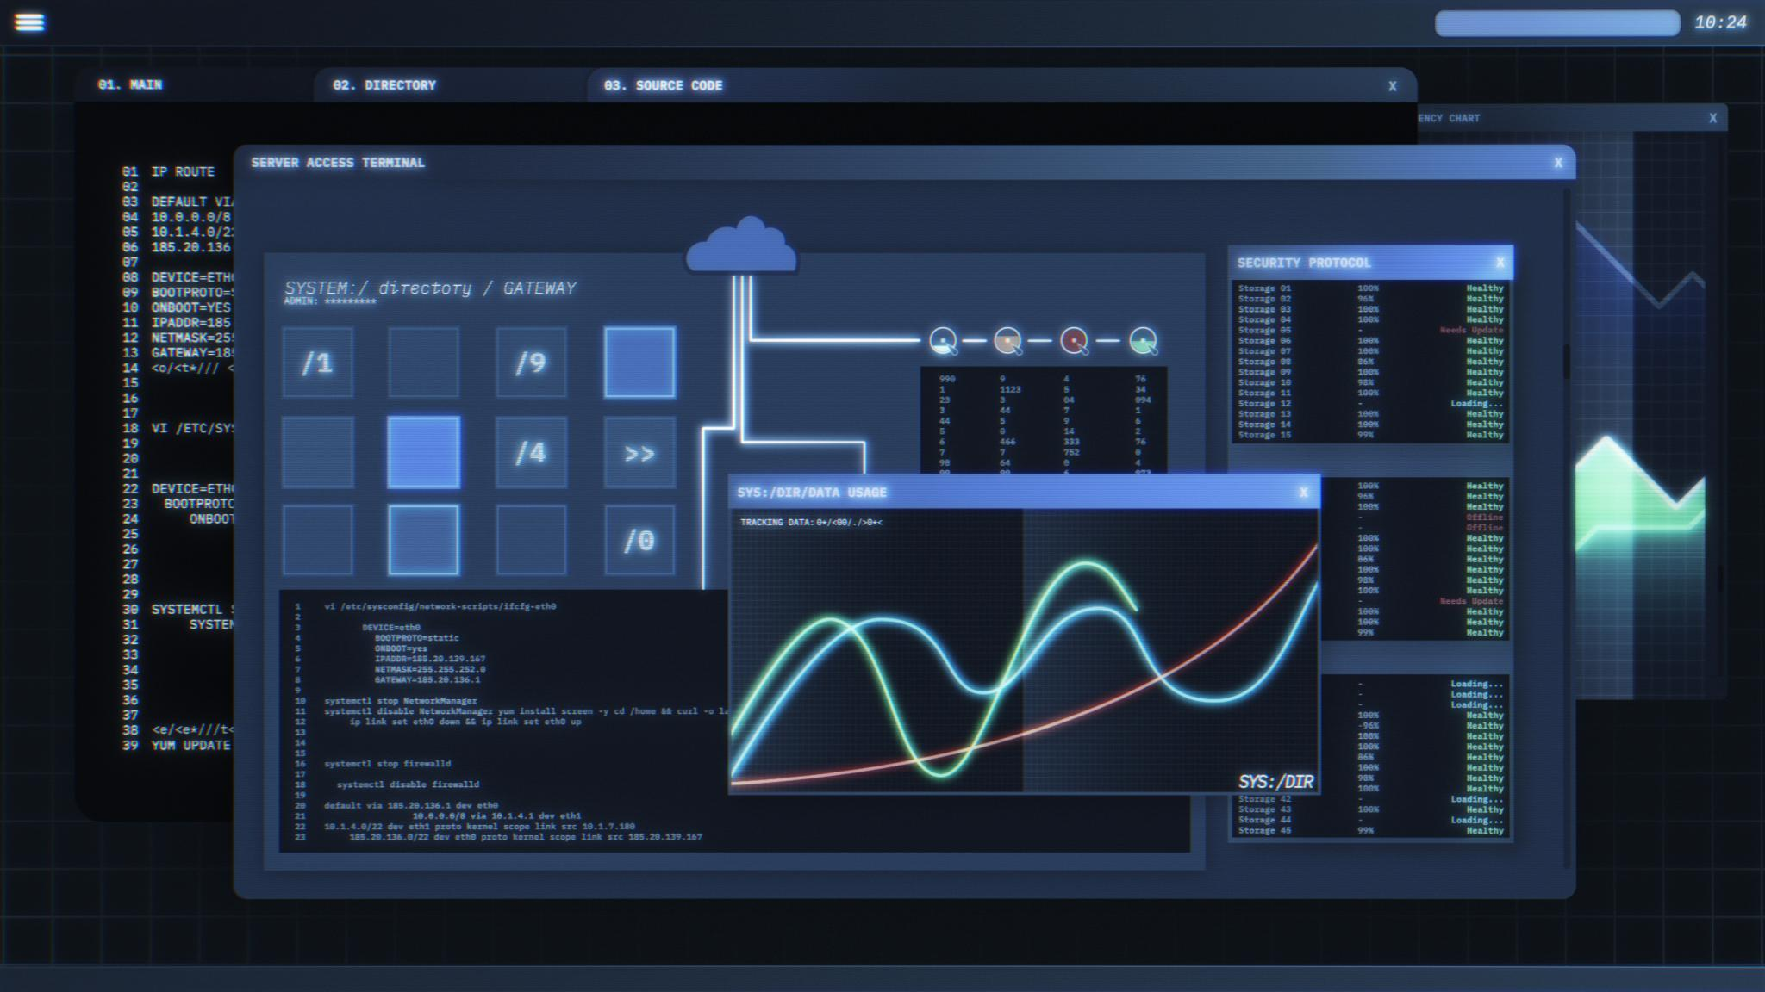
Format Window and Project Explorer
Format Window Functions
  The Format window helps align and arrange controls, ensuring consistent and professional form layouts.
Project Explorer Overview
  Project Explorer provides a hierarchical view of forms, modules, and classes to manage project components efficiently.
Enhanced Development Efficiency
  Using these windows together improves navigation and layout consistency, boosting overall development productivity.
Notes:
The Format window in VB6 provides options for aligning and arranging controls on a form, ensuring a professional and consistent layout. Developers can use commands like Align, Make Same Size, and Space Evenly to organize controls visually, improving usability and aesthetics. The Project Explorer window, on the other hand, serves as the central hub for managing project components. It displays a hierarchical view of all forms, modules, and classes within the project, allowing developers to switch between elements quickly. Through Project Explorer, users can add new forms, remove components, and access code modules, streamlining project organization. These tools are vital for maintaining structure in larger applications, where multiple forms and modules must be coordinated. Effective use of the Format window and Project Explorer enhances development efficiency, as developers can focus on functionality without being hindered by layout inconsistencies or navigation challenges. Together, these components exemplify VB6’s emphasis on visual design and modular organization, which remain key principles in modern IDEs.

Slide 21

Properties, Form Layout, and Toolbox
Properties Window
  Allows configuration of object attributes like size, color, font, and behavior at design or runtime.
Form Layout Window
  Displays a visual representation of form positioning to help align applications with user expectations.
Toolbox of Controls
  Contains controls like buttons, text boxes, labels, and timers for building interactive interfaces.
Interactive Interface Development
  Drag and drop controls onto forms and customize them to create intuitive and functional user interfaces.
Notes:
The Properties window in VB6 allows developers to configure object attributes such as size, color, font, and behavior. Properties can be set at design time or modified dynamically during runtime through code. This flexibility enables precise control over the user interface and application functionality. The Form Layout window provides a visual representation of form positioning on the screen, helping developers design applications that align with user expectations. The Toolbox contains a collection of controls, including buttons, text boxes, labels, and advanced components like timers and data controls. These controls are essential for building interactive and functional interfaces. Developers can drag and drop controls onto forms, then customize their properties and write event procedures to define behavior. Mastery of these components ensures efficient design and coding, as developers can create intuitive interfaces while maintaining control over application logic. Understanding how these tools interact within the VB6 environment prepares students for advanced topics such as dynamic control creation and custom component development.

Slide 22

Main Visual Window, Toolbar, and Form Information
Main Visual Window Functionality
  The main visual window shows the active form and provides a drag-and-drop canvas for designing interfaces quickly.
Toolbar Features
  The toolbar offers quick access to commands like Save, Run, Stop, and shortcuts for formatting controls and properties.
Form Location and Size
  Form size and position settings ensure applications fit screens well, adjustable via properties or code.
Notes:
The main visual window in VB6 displays the active form during design, serving as the canvas for arranging controls and configuring layout. This window supports drag-and-drop functionality, enabling rapid interface creation. The Toolbar provides quick access to essential commands such as Save, Run, and Stop, streamlining development tasks. It also includes shortcuts for formatting controls and accessing properties. Form location and size information is critical for designing applications that fit various screen resolutions and user preferences. Developers can view and adjust these parameters in the Properties window or through code, ensuring consistent presentation across devices. Understanding these components enhances productivity, as developers can efficiently design, test, and refine interfaces. These tools exemplify VB6’s focus on visual development, where intuitive design complements robust coding capabilities. By mastering the main visual window, toolbar, and form information, students gain the skills needed to create polished and user-friendly applications.

Slide 23

Design Time, Run Time, and Break Time
Design Time Stage
  During design time, developers build the user interface and write code within the IDE, configuring properties and controls.
Run Time Stage
  Run time happens when the application executes, allowing interaction and functional testing to identify errors.
Break Time Stage
  Break time pauses execution for debugging, inspecting variables, and evaluating expressions using debugging tools.
Notes:
Visual Basic 6.0 development occurs across three distinct stages: design time, run time, and break time. Design time refers to the phase where developers create the user interface and write code within the IDE. During this stage, properties are configured, controls are added, and event procedures are defined. Run time occurs when the application is executed, allowing developers to observe behavior and interact with the interface as end-users would. This stage is crucial for testing functionality and identifying logical errors. Break time is initiated when execution is paused, typically through breakpoints or manual interruption, enabling developers to inspect variables, evaluate expressions, and debug issues. VB6 provides tools such as the Immediate window and Watch expressions to facilitate debugging during break time. Understanding these stages is essential for effective development, as each serves a unique purpose in the software lifecycle. Mastery of design, run, and break time ensures that developers can create, test, and refine applications systematically, reducing errors and improving overall quality.

Slide 24

Writing Your First Visual Basic Project
Project Setup and Interface Design
  Launch VB6 IDE, select Standard EXE template, and design the form using Toolbox controls.
Configuring Control Properties
  Adjust control attributes such as captions, colors, and sizes in the Properties window to finalize design.
Writing Event-Driven Code
  Write event procedures in the code editor to define UI behavior like button click responses.
Testing and Debugging
  Run the application within the IDE, use breakpoints and Immediate window to debug errors effectively.
Notes:
Creating your first Visual Basic 6.0 project involves several key steps that introduce fundamental concepts of application development. Begin by launching the VB6 IDE and selecting a Standard EXE project template. This creates a default form, which serves as the main interface. Next, use the Toolbox to add controls such as labels, text boxes, and command buttons to the form. Configure properties for each control in the Properties window, adjusting attributes like captions, colors, and sizes to match design requirements. Once the interface is complete, write event procedures in the code editor to define behavior. For example, a button click event might display a message or process user input. Test the application by running it within the IDE, observing functionality and making adjustments as needed. Use breakpoints and the Immediate window to debug errors during execution. Finally, compile the project into an executable file for distribution. This process demonstrates VB6’s emphasis on visual design and event-driven programming, providing a practical foundation for more complex projects. By completing this exercise, students gain confidence in navigating the VB6 environment, manipulating objects, and writing functional code, which are essential skills for any aspiring developer.

Slide 25

Summary of Key Concepts
VB6 Environment Overview
  Students explored VB6 components like Project Explorer, Properties window, and Toolbox for project management and design.
Object Model and Event Programming
  The object model forms the foundation for event-driven programming with objects, properties, methods, and events.
Practical Programming Skills
  Writing projects, configuring controls, and implementing event procedures developed practical VB6 skills.
Development Stages and Debugging
  Understanding design time, run time, and break time stages aids effective development and debugging.
Notes:
This module on Visual Basic 6.0 has covered essential topics for understanding and developing Windows applications. Students explored the VB6 environment, including components like the Project Explorer, Properties window, Toolbox, and Form Layout window, which facilitate visual design and project management. The object model was introduced as the foundation for event-driven programming, emphasizing objects, properties, methods, and events. Practical skills were developed through writing projects, configuring controls, and implementing event procedures. Advanced concepts such as design time, run time, and break time were discussed to highlight the stages of development and debugging. By mastering these elements, learners are equipped to create functional applications, troubleshoot issues, and appreciate VB6’s role in the evolution of programming tools. This knowledge not only supports academic success but also provides a stepping stone to modern languages and frameworks, ensuring students remain adaptable in a rapidly changing technological landscape.

Slide 26
Summary and Review Exercises
Read Chapter Summary Notes on Page 84 of Introduction to Programming Book 1.
Complete all 15 review questions on Page 85 of Introduction to Programming Book 1.
Try to at least complete any 2 questions on Programming Exercises on Pages 86 – 87.

Slide 27
PS: Programmers Day!
  Programmers Day is a day that honors programmers and innovators who make human lives easier by innovating and designing computer programs. This day is popularly celebrated on every 13 September every year, or on September 12 in leap years.

